Slide 1
www.autismcop.com

Slide 2
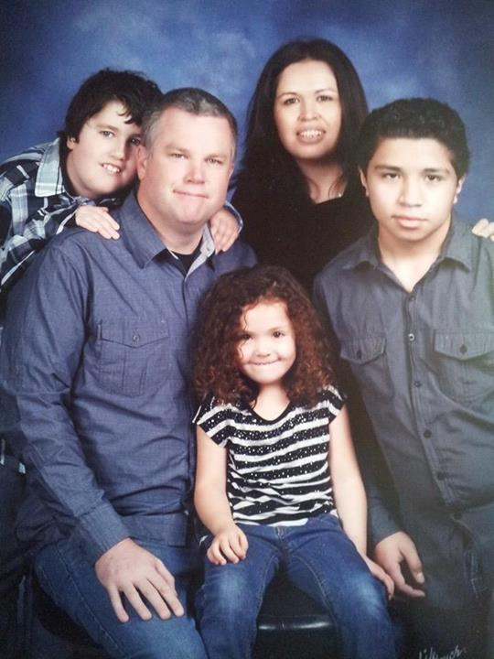
My Journey

Slide 4
What you will hear today:
Bridging the Gap with First Responders
Current Status of EM for Special Needs
Prepare for Disasters in Your Home
Safety Risks in Your School

Slide 5
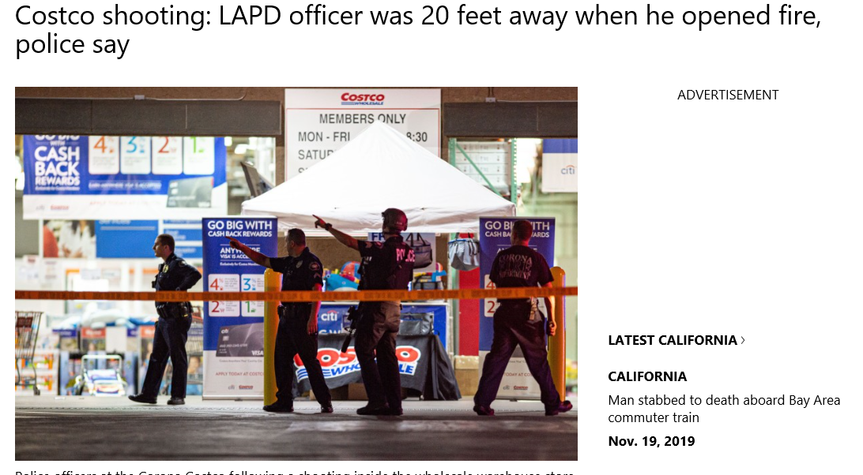

Slide 6
What is the first thing a first responder attempts to gain when he first responds to a location or scene?

Slide 7
CONTROL

Slide 8
DISCLOSURE

Slide 9
DURING THE INCIDENT IS TOO LATE TO START TO PREPARE!

Slide 10
Current Status of Emergency Management
Although there has been significant progress the world of emergency management / disaster preparedness is not prepared for dealing with persons with special needs

Slide 11
Current Status of Emergency Management
https://www.fema.gov/pdf/about/odic/all_hands_0411.pdf

Slide 12
Current Status of Emergency Management
ADA has accommodation guidelines in policy, however funding and availability often override the requirement.
Plan on Being on Your Own

Slide 13
In Your Home

Slide 14
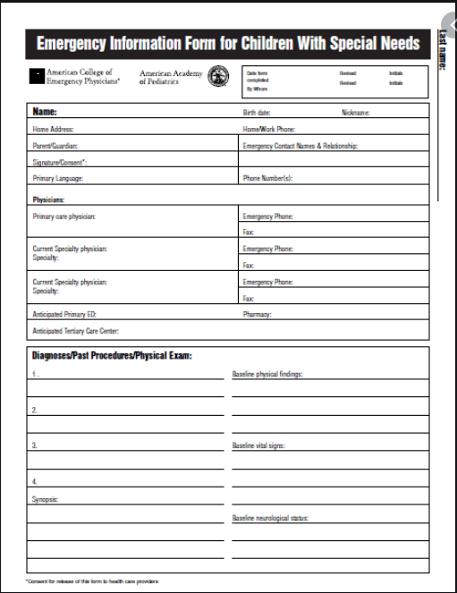
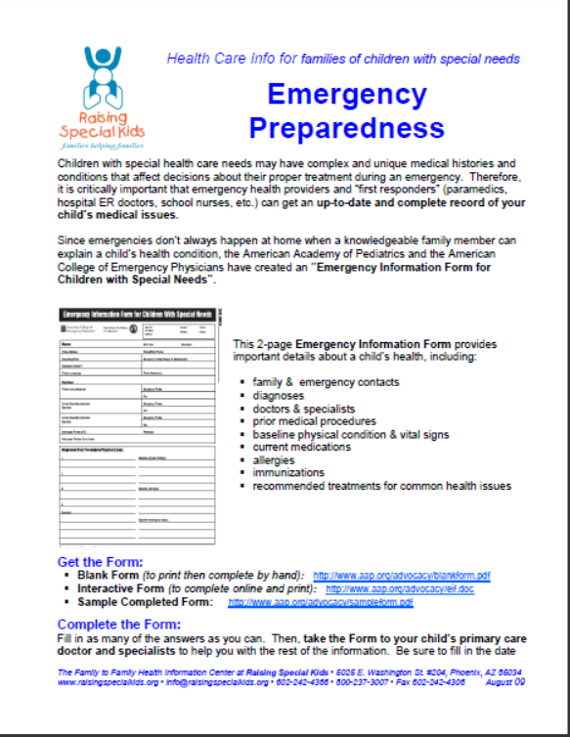
Information Sheets

Slide 15
Place to put information sheets:
Fridge
Glove Box
Neighbors
Safe – Important Papers
School

Slide 16
Law Enforcement / Fire
Enroll in any type of system possible

Slide 17
“Go Bag”
Flash Drive:
Current Photo
Info Sheet
Any Legal Paperwork
List of medications
Phone numbers
Medications – 30 Day Supply
Sensory Needs – Ear plugs, something to cover up with, sunglasses
Non perishable food item
Stimming item / comfort item / candy / bubbles
Plain labels – Pre filled “Non verbal”, “Have autism”
Cash

Slide 18
Wildfires
Have a “Go Bag”
Alternate pick up person / caregiver
Masks
Eye Protection
Reflective Jacket
Predetermined Meeting Location

Slide 19
Earthquakes
Go Bag
Who is responsible for who?
How to exit windows
First Aid Kit
Sensory Issues
Prepare for aftershocks
Meeting Location

Slide 20
Power Outages
Go Bag
Flashlights
Phone Battery Packs
Generators
Prep for a long haul
Blankets
Sensory Issues

Slide 21
Schools

Slide 22
Police Involvement?
What is policy?
What steps are taken prior to?
When is okay to move right to police involvement?

Slide 23
Active Shooter Plan
Shelter in Place / Evacuate
How to keep kids quiet
Barricade

Slide 24
INJURY REPORTS
EMERGENCY KITS

Slide 25
Areas of concern
Restrooms
Playgrounds
Cafeteria
Transportation
How to respond to “sexual issues”

Slide 26
Meet and talk to your
School Resource Officers

Slide 27
Overall Disaster Plan
Explain Roles / Responsibilities
Include Neighbors
Photo’s
Stickers “No Speech” “Autism”
Food Storage
Comfort Items
Emergency Forms

Slide 28
Questions?

